Slide 1
Banner 9 Upgrade
Breakfast Bytes
March 21, 2019
Division of Information Technology & Library Services

Slide 2
Agenda
Banner 9 Differences
  New Capabilities
  Web-Application is more intuitive
  Messages are more user friendly
2. Training Opportunities
  Department Led/In-depth Training
  Basic Navigation Training
  Self-Service Training
3. Roll-Out Strategy

Slide 3
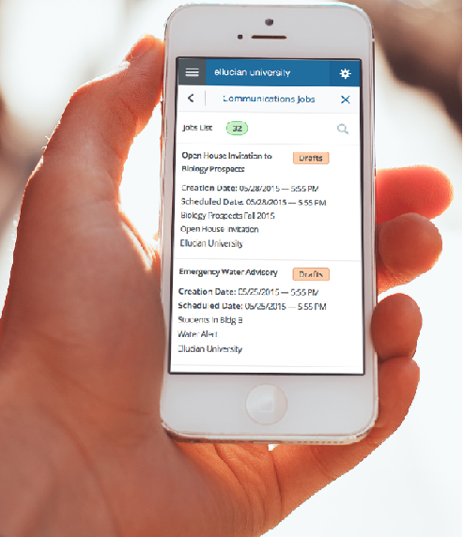
New and improved Banner9 Administrative applications
Ellucian added significant new
capabilities to its Banner 9 applications,
creating a modern, intuitive user
experience and flexible configuration.
End dependency on Internet Explorer and allow for full browser support
(Chrome, Firefox, Safari, MS Edge)
New and improved Banner 9
Self-Service applications written
to be Mobile First!

Slide 4
Enhancements
New functionality within forms, impacts how the data can be queried and viewed
No changes to how the data is stored or backend processes
  Filters
  Better warning messages
  Adjust columns
  Sort data within the forms
  More intuitive look and feel

Slide 5
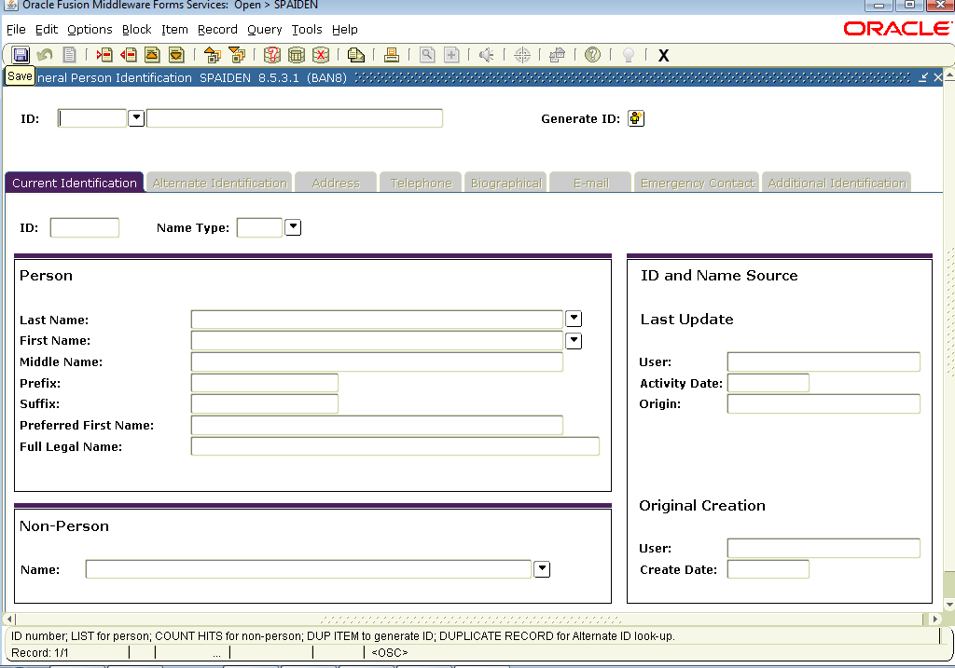
Example of Banner 8 form – look and feel
Technical icons that were not intuitive.
Banner 8 Forms have a
look-and-feel from the 1990’s.
Rigid blocks with very little flexibility
No obvious method of moving from block to block
Cryptic messages that were not very helpful

Slide 6
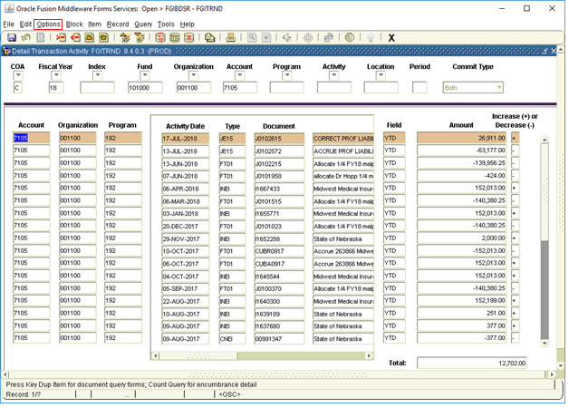
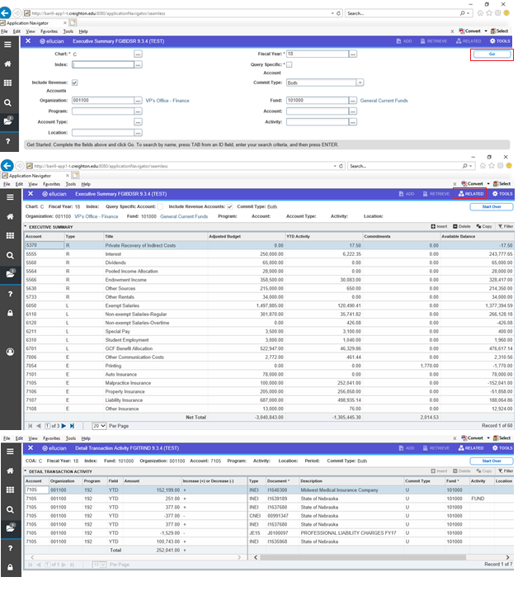
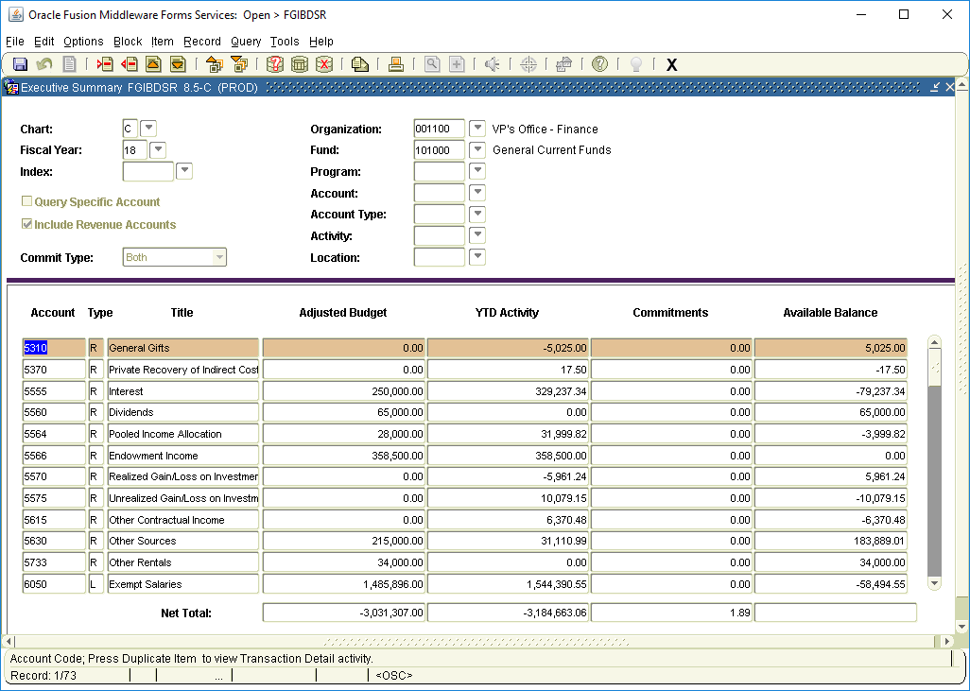
More intuitive web interface
Banner 8 forms example
Corresponding Banner 9 forms

Slide 7
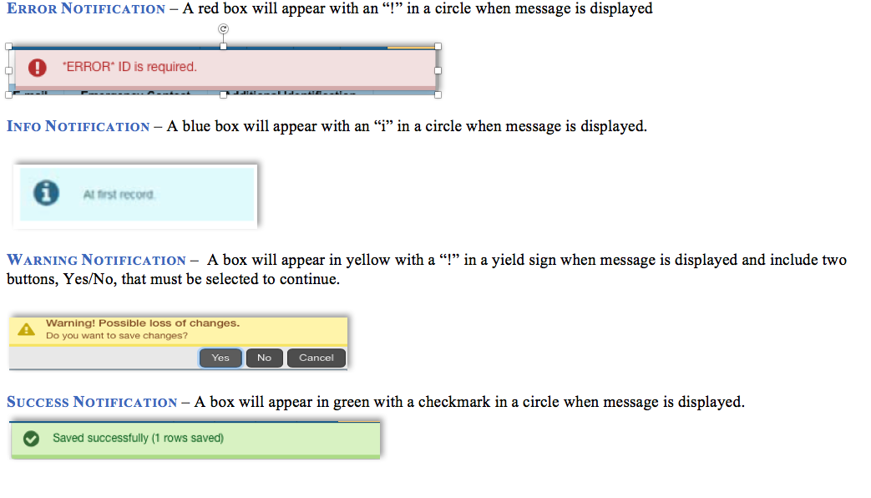
Banner 9 User Friendly Messages

Slide 8
Training
Department Led
  Registrar
  Finance
  Financial Aid
  Business Office
Basic Navigation
  Several campus sessions held in March
  Additional sessions will be scheduled
Self-Service
  FAQs
  Banner 9 Resources

Slide 9
Banner 9 Rollout Plan
March 2019 | April 2019 | May 2019 | June 2019 | July 2019
Finance; Business Office; Financial Aid; Registrar
All of Campus
Banner 9 Rollout
Banner 9 Custom Forms Rollout Period (not including student health forms)
Training – Department Led/Power Users; Basic Navigation Sessions; Self-Service/Campus-Wide
Banner 8 Forms continued use while transition to Banner 9

Slide 10

QUESTIONS

